Slide 1
Continuous Distributions

Slide 2
Continuous random variables
A continuous random variable can take any value in an interval, open or closed, so it has innumerable values
Examples: the height or weight of a chair
For such a variable X, the probability assigned to an exact value P(X = a) is always 0, though the probability for it to fall into interval [a, b], that is, P(a ≤ X ≤ b), can be a positive number

Slide 3
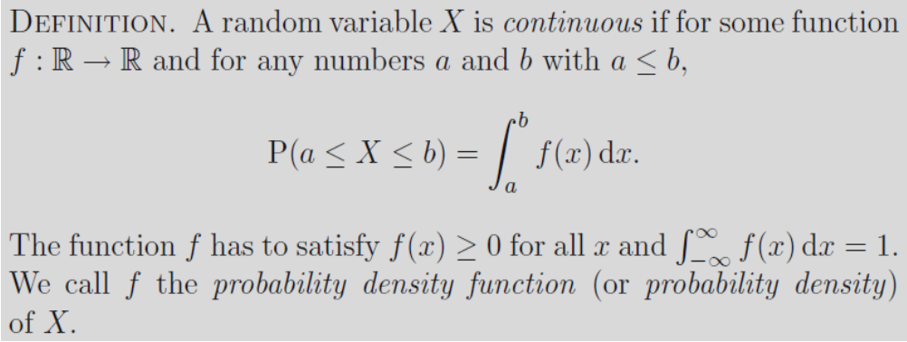
Probability density function
One way to get P(a ≤ X ≤ b): to integrate the probability density function of X

Slide 4
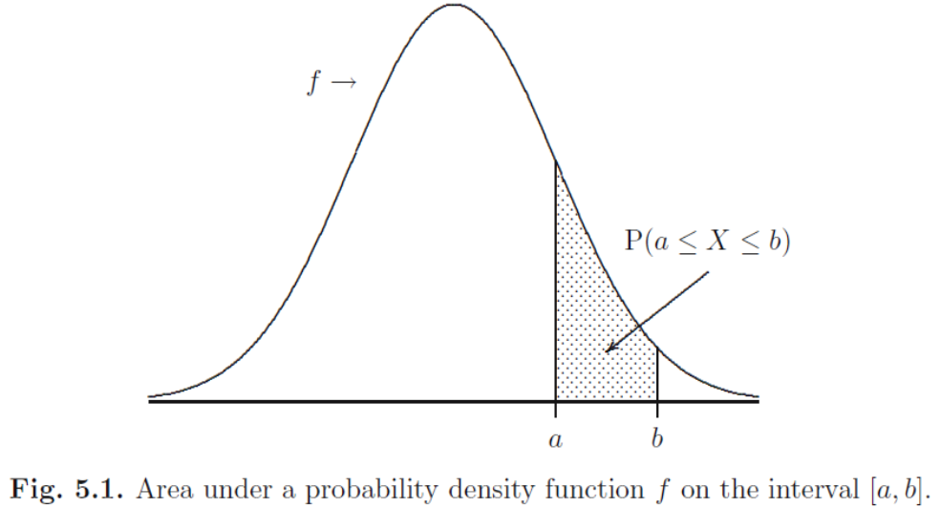
Probability density function (2)
P(a ≤ X ≤ b) = P(a < X ≤ b) = P(a < X < b) = P(a ≤ X < b)

Slide 5
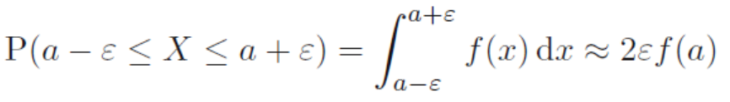
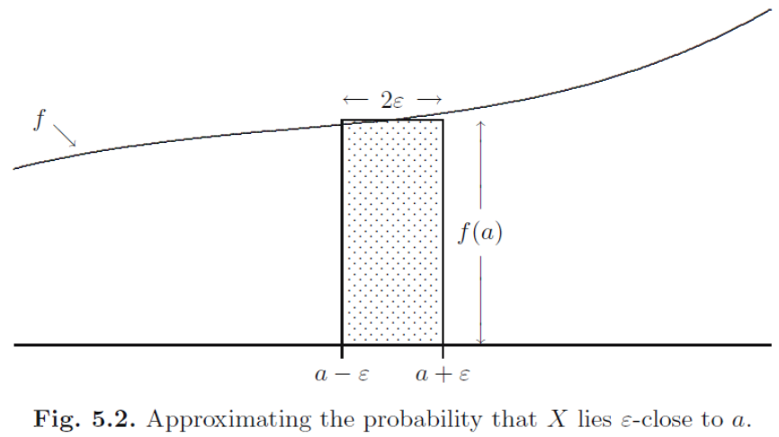
Probability density function (3)

Slide 6

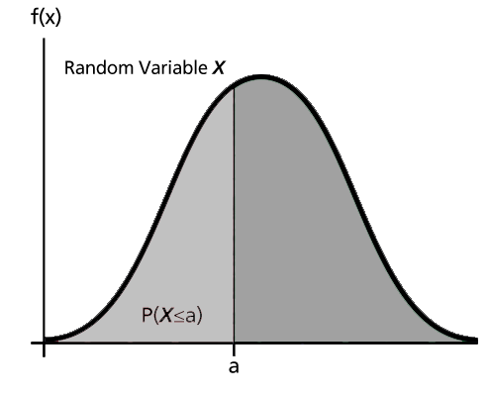
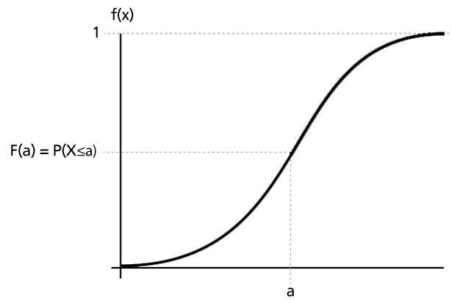
Cumulative distribution function
F(b) is still defined as P(X ≤ b), or P(-∞ < X ≤ b)

Slide 7
Cdf (2)
Another way to get P(a ≤ X ≤ b):
P(a < X ≤ b) = P(X ≤ b) – P(X ≤ a) = F(b) – F(a)
A discrete random variable has no pdf f(x), a continuous random variable has no useful pmf p(x), but both have cdf F(x)
 |  | Discrete
 | P(E) | p(a) = P(X = a)
Continuous | f(a) ≈ P(a-ε < X < a+ε)/2ε | F(a) = P(X ≤ a)
P | p
f | F

Slide 8
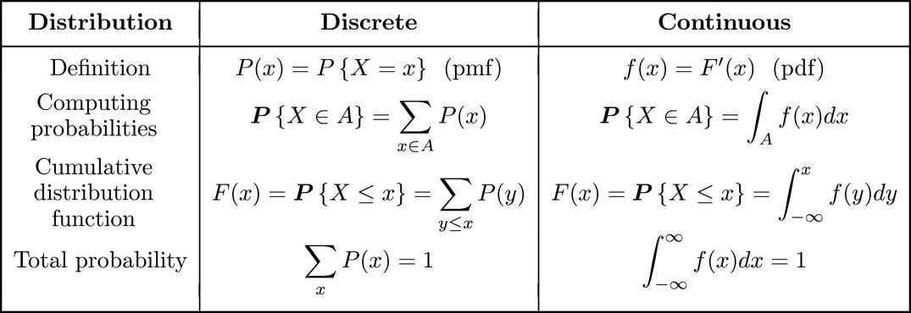
Pmf p(x) versus pdf f(x)

Slide 9
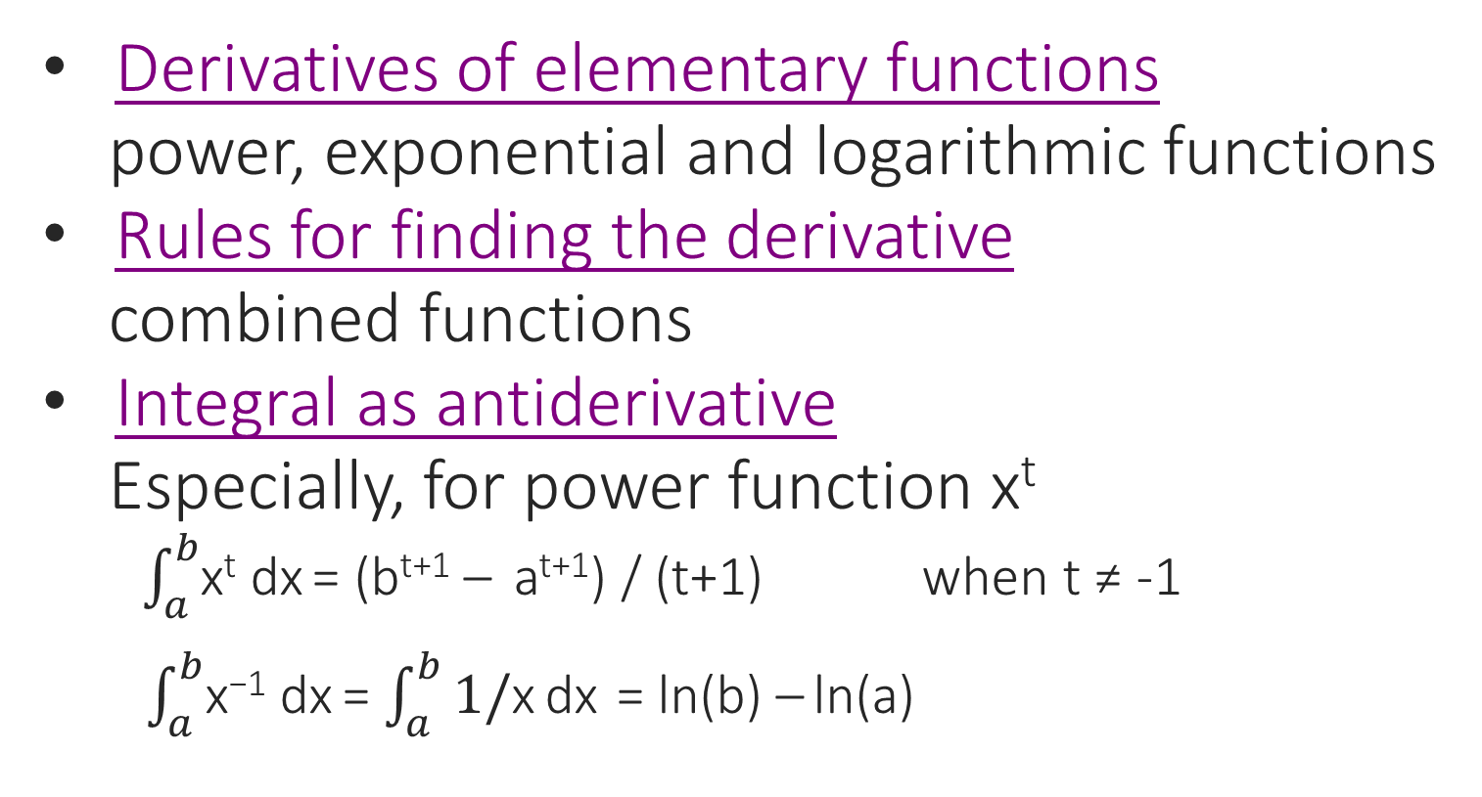
Review: derivative and integral
Derivatives of elementary functions
power, exponential and logarithmic functions
Rules for finding the derivative
combined functions
Integral as antiderivative
Especially, for power function x^{t}
$\int_{a}^{b}{\text{x}\text{t}}$dx = (b^{t+1} – a^{t+1}) / (t+1) when t ≠ -1
$\int_{a}^{b}{\text{x}\text{−1}}$dx = $\int_{a}^{b}{\text{1/}\text{x}}$dx = ln(b) – ln(a)

Slide 10
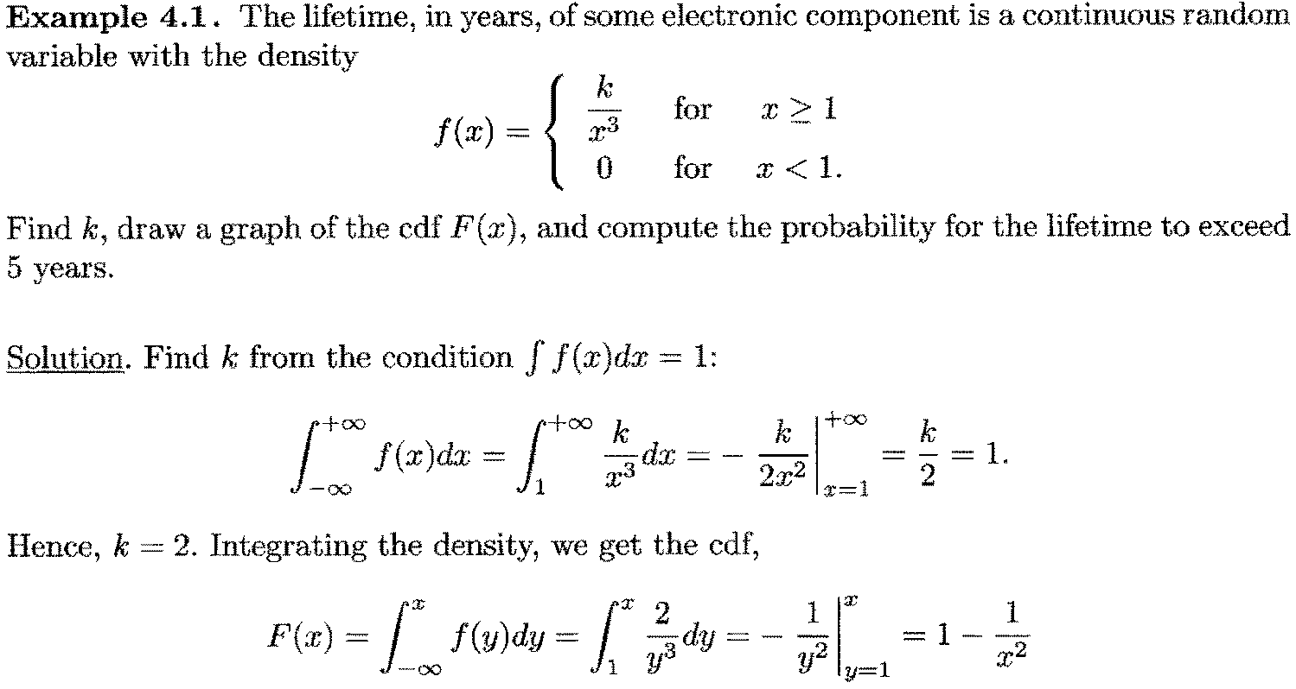
Example 4.1 (1)

Slide 11
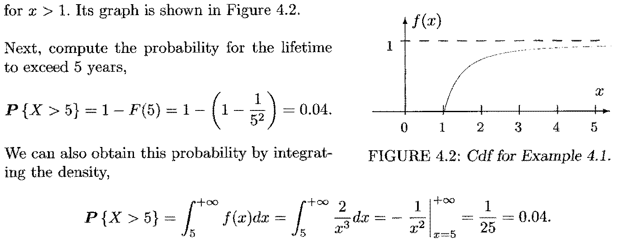
Example 4.1 (2)

Slide 12
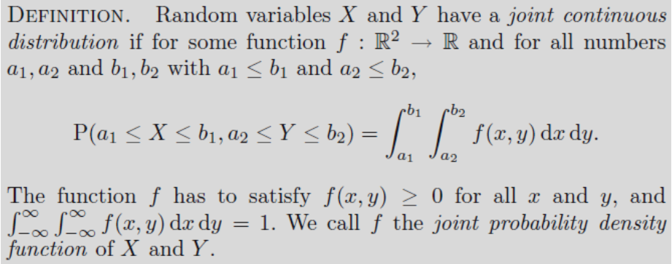
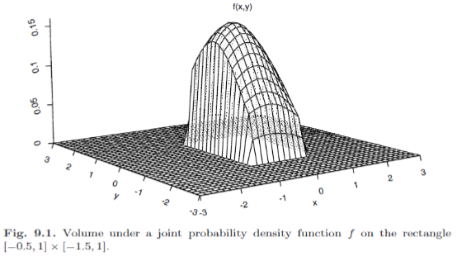
Joint distributions: continuous

Slide 13
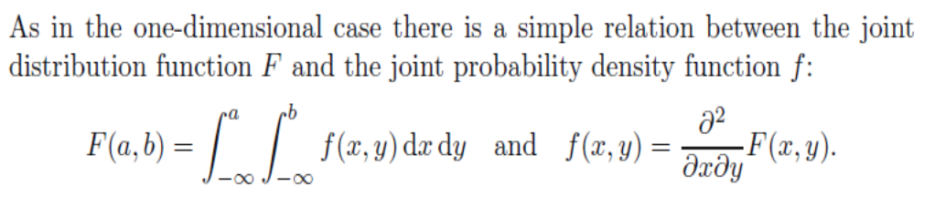
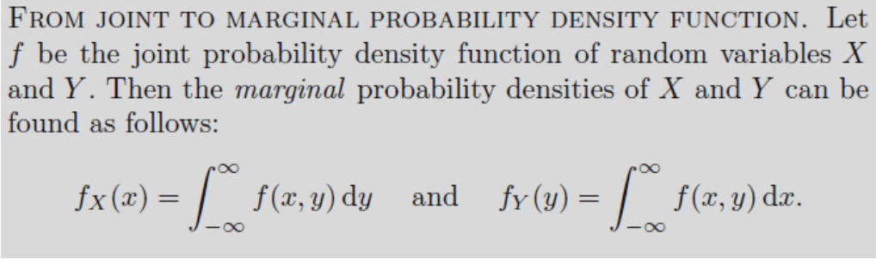
Joint distributions: continuous (2)

Slide 14
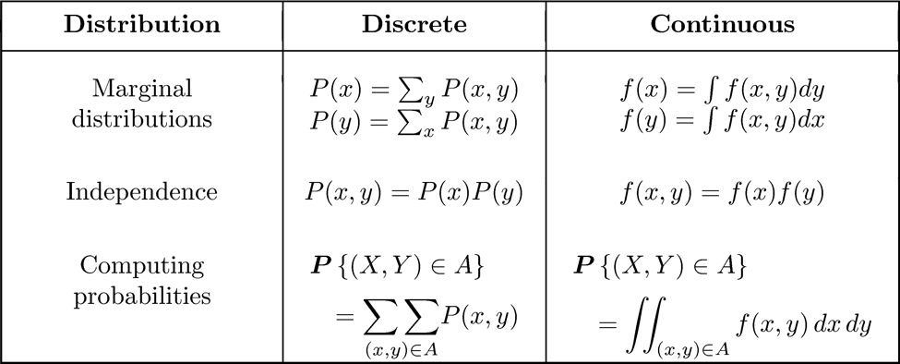
Pmf p(x) versus pdf f(x): joint

Slide 15

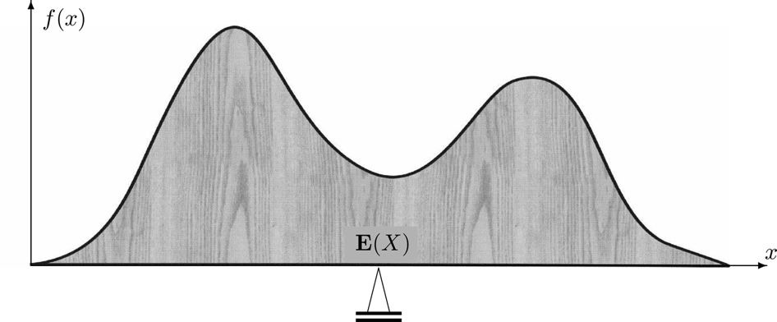
Expectation of continuous variable

Slide 16
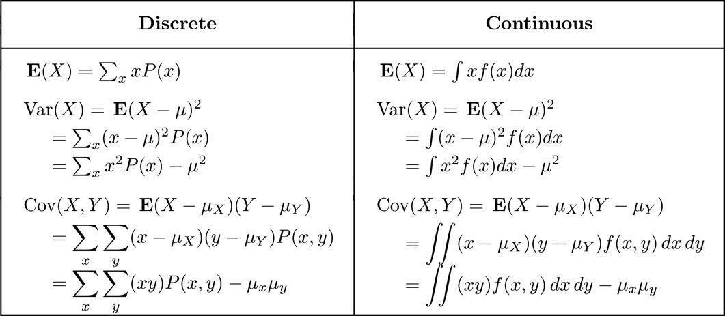
p(x) vs. f(x): E[X] and Var(X)

Slide 17
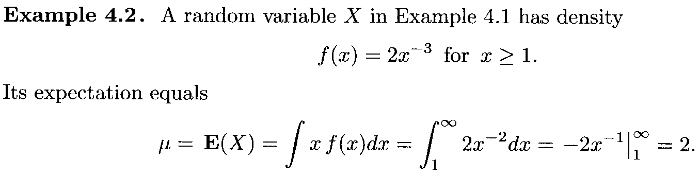
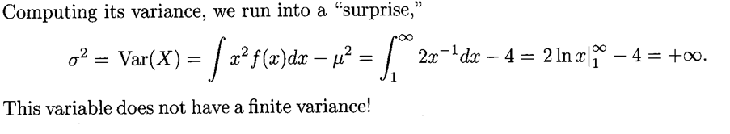
Example 4.2

Slide 18
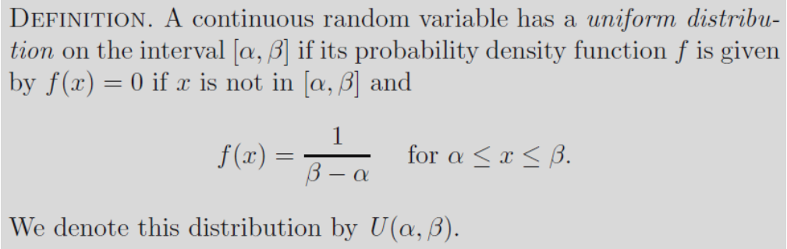
Uniform distribution
The distribution function F of a random variable that has a U(α, β) distribution is given by
F(x) = 0 if x < α
F(x) = (x − α) / (β − α) if α ≤ x ≤ β
F(x) = 1 if x > β

Slide 19
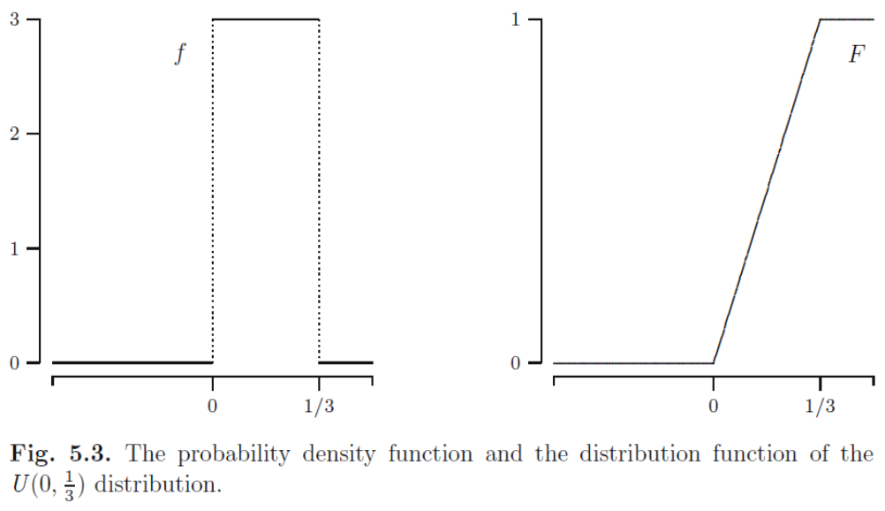
Uniform distribution (2)

Slide 20
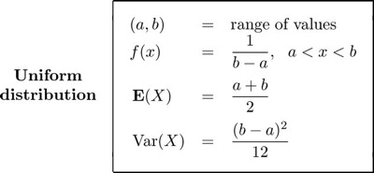
Uniform distribution (3)
U(0, 1) is called Standard Uniform distribution
Its density is f(x) = 1 for 0 < x < 1
If X is U(a, b), then Y = (X – a) / (b – a) is U(0, 1)

Slide 21
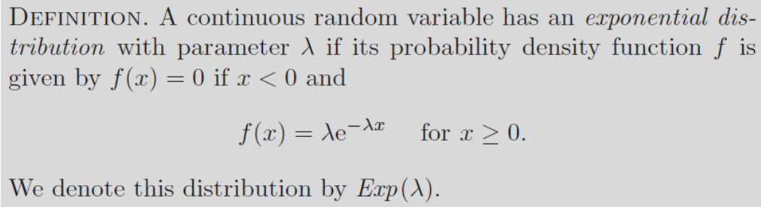

Exponential distribution
When the number of events is Poisson, the time between events is exponential
E[X] = 1 / λ, Var(X) = 1 / λ²

Slide 22
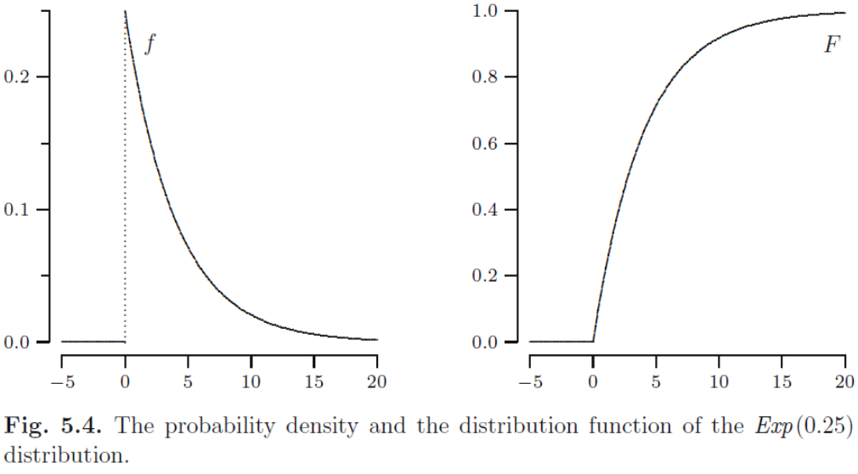
Exponential distribution (2)

Slide 23
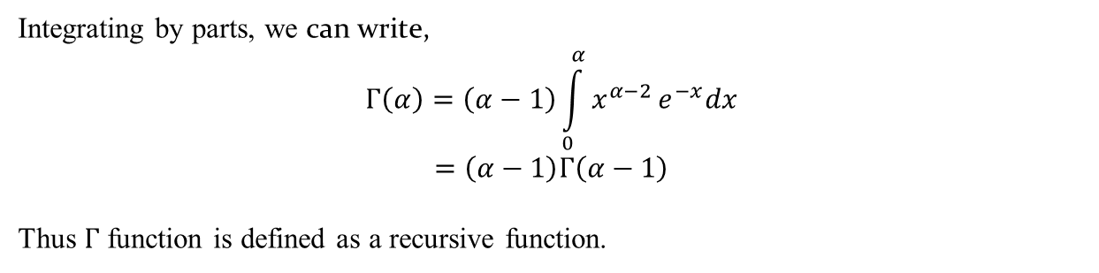

Gamma Function
The gamma distribution derives its name from the well known gamma function in mathematics.
$Γ\left(α\right)=\int_{0}^{α}{x^{α−1}}e^{−x}dx$ for $α>0$
Definition 4.11: Gamma Function
Integrating by parts, we can write,
$$Γ\left(α\right)=\left(α−1\right)\int_{0}^{α}{x^{α−2}}e^{−x}dx$$
$$=\left(α−1\right)Γ\left(α−1\right)$$
Thus $Γ$ function is defined as a recursive function.

Slide 24

Gamma Distribution
When $α=n$, we can write,
$Γ\left(n\right)=\left(n−1\right)\left(n−2\right)……….Γ(1)$
$$=\left(n−1\right)\left(n−2\right)……….3.2.1$$
$=\left(n−1\right)$!
Further, $Γ\left(1\right)=\int_{0}^{∞}{e^{−x}dx}=1$
Note:
$Γ\left(\frac{1}{2}\right)=\sqrt{π}$ [An important property]

Slide 25
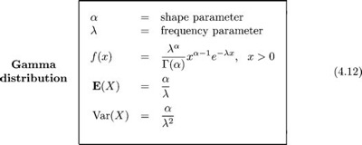
Gamma distribution
When a process consists of α independent steps, and each step takes Exp(λ) amount of time, then the total time has a distribution Gamma(α, λ), though α may not be an integer

Slide 26
Gamma distribution (2)

Slide 27
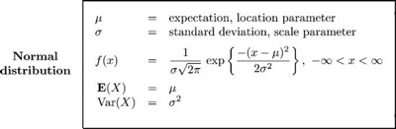
Normal distribution
Normal (Gaussian) distribution N(μ,σ²) is often used as a model for physical variables like weight, height, temperature, or examination grade.

Slide 28
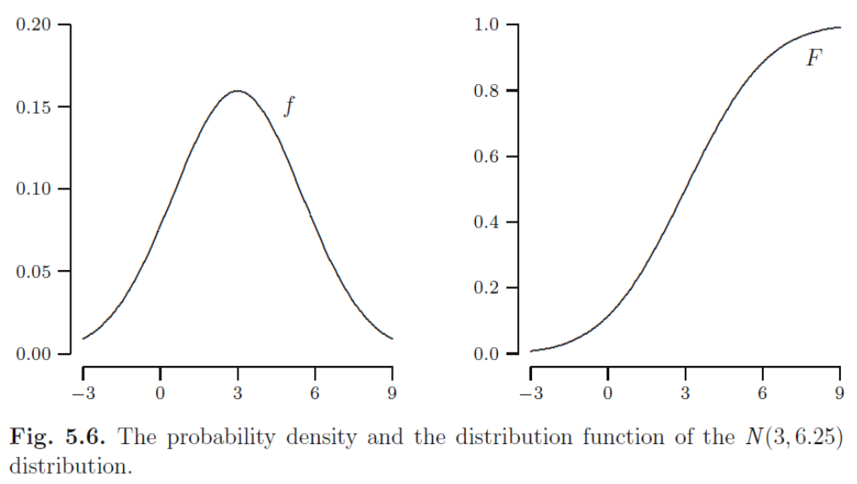
Normal distribution (2)

Slide 29

Normal distribution (3)
Bin(n, p) ≈ N(np, np(1 – p)) when n is large, and p is moderate.
N(0, 1) is called Standard Normal distribution, written as φ(x).

